Slide 1



Multimodal Emotion Recognition Using Large Audio-Language Models
ASHKAN SHAFIEI S342583
PARASTOO ALAVI S340942
AMIR MASOUD ALMASI S337006
Notes:
Hello everyone , and thank you for being here ,As you know Our project is Multimodal Emotion Recognition Using Large Audio-Language Models.
In simple terms, we explored how AI can understand not only what we say, but how we say it - the emotion behind the words.
Why does this matter?
Because emotions are at the center of human communication. And if AI is going to support people , especially in sensitive areas like mental health . it needs to understand feelings, not just text.
So today, we’ll walk you through the story of how we designed, developed, and evaluated a system that tries to do exactly that.

Slide 2

PART OF A BIGGER PICTURE
“While AI systems can be used to enhance social skills, they could also affect people’s physical and mental wellbeing.”
European Commission
Notes:
Well, Even when someone says something simple like ‘I’m fine,’ the emotion behind the voice may tell a completely different story.
The EU Ethics Guidelines remind us that AI must always respect , support, protect human transparency, fairness, and well-being.
So from the very beginning, we approached this project with a question:
How can we build an AI that supports people emotionally, instead of misinterpreting or harming them?
This ethical mindset shaped every design choice we made.
In many projects, you usually have three categories of impact:
financial , environmental , and social impact.For our project, the priority is clearly the social dimension.
Why? Because emotion recognition is fundamentally about people — about understanding human feelings, communication challenges, and mental well-being.

Slide 3
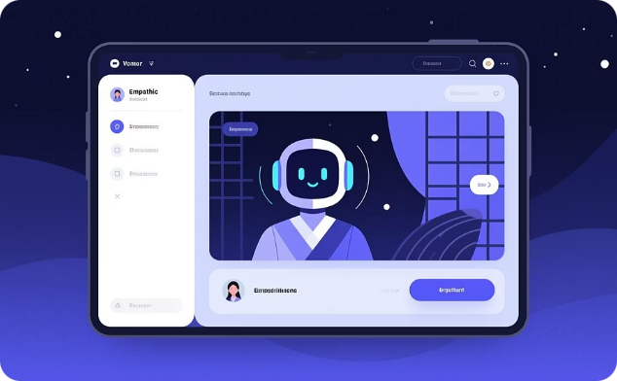

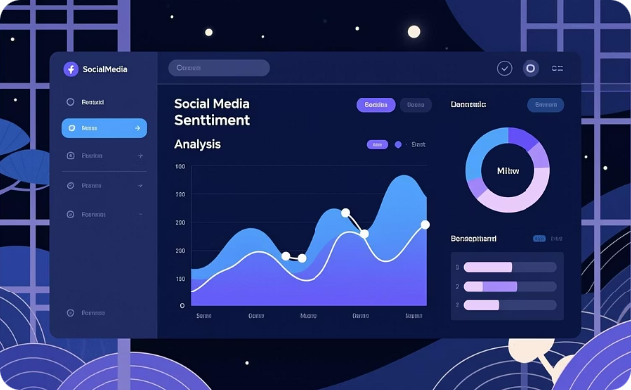
REAL-WORLD IMPACT & APPLICATIONS
Human-Computer Interaction
Healthcare Monitoring
Social Media Analysis
Empathetic virtual assistants and intelligent tutoring systems that adapt to user emotional states, providing personalized support and natural conversations.
Continuous tracking of patient emotional states enables personalized mental health care, early intervention for depression or anxiety, and improved therapeutic outcomes.
Detecting sentiment shifts and mental health signals from multimodal posts—combining text, voice notes, and images—for community wellbeing and crisis prevention.
Notes:
this project is not just a research idea, but something with real-world impact across several domains including Human–Computer Interaction ,Emotion-aware systems allows machines to respond more naturally and more supportively. about Healthcare Monitoring it can continuously track emotional states from speech and language, which helps with:
Early detection of anxiety, depression, or emotional instability and for the Social Media Analysis Our system can analyze these multimodal signals to:
Identify mood changes or crisis signals which is relevant for public safety, psychological research, and content moderation.
And the importance of emotion recognition is evidence in many areas, but for our work we focus on healthcare

Slide 4
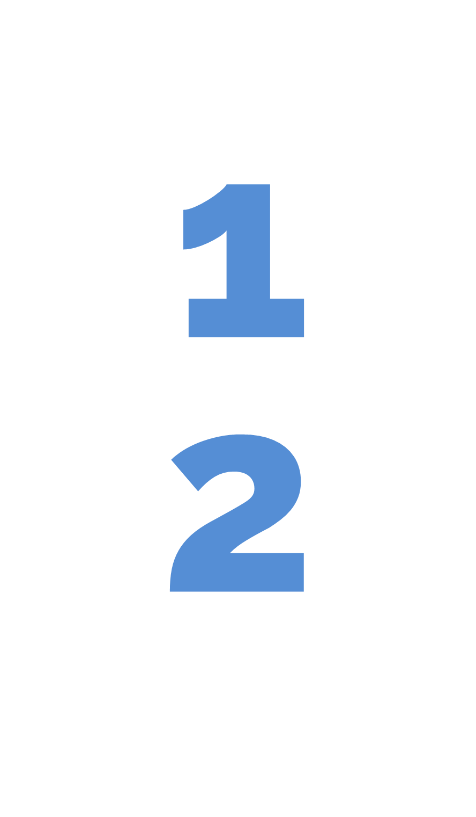

PROJECT GOALS
Design a multimodal AI system to detect emotion
Promote human-centered and ethical ai systems
Notes:
We built this project around two goals.
The first goal was very technical: create a multimodal AI system that merges audio and text to understand emotion more accurately.
The second goal is equally important: (make sure this system respects humans and ethical principles.)
We want AI systems that support people while respecting privacy,
That means the model shouldn’t just be accurate — it should be fair, transparent, respectful of privacy, and actually helpful in clinical or real-world environments.

Slide 5




IMPROVED EMOTIONAL WELL-BEING
DATA-DRIVEN HEALTH INSIGHTS
VALUE PROPOSITIONS
ENHANCED PATIENT SUPPORT SYSTEMS
RESPONSIBLE & HUMAN-CENTERED AI
Notes:
Here we show what our system brings to the table.
First, it helps with emotional well-being.
Think of it as giving clinicians an extra sense — a way to catch emotional changes that patients might not express directly.
(It can help individuals understand and track their emotional states.)
Second, it brings data-driven insights.
Instead of guessing how someone is feeling over time, we finally have objective signals from speech and text that make emotional health more measurable.
(Clinicians and researchers get objective emotional information.)
Third, it leads to better patient support.
A valuable tool for individuals with communication challenges
( imagine digital tools that can understand when someone sounds stressed or down, and respond in a more helpful way.)
And lastly, everything is built with responsibility in mind , So the goal is not to replace professionals, but to empower them with better emotional understanding.

Slide 6

SUSTAINABLE DEVELOPMENT GOALS
Notes:
This project is connected to several UN Sustainable Development Goals.
In particular:
Good health and well-being through mental health monitoring, this matters to our project because mental health is a core part of overall well-being. By using AI to detect emotional states and support therapists and patients, we’re contributing directly to the goal of improving health and early intervention.
Reduced inequalities by helping individuals who struggle to express emotions
Responsible innovation :Our project aligns with it by introducing innovative AI infrastructure to support mental-health technologies.and because we’re using cutting-edge AI to build better digital tools for mental health. It’s all about bringing smarter, more reliable tech into healthcare
The last one which is all about collaboration — bringing together universities, industry, researchers, and institutions to solve problems
Our project fits here because we’re not doing this alone: we work with LINK’s foundation, we use open-source models, shared datasets, and GitHub collaboration.
and also it can be useful for clinical researchers communities
The whole project is basically a mix of teamwork, shared resources, and co-creation — which is exactly what SDG 17 promotes.”
Our project directly aligns with this goal because it is built through collaboration between students, clinicians, and the research community.
We rely on shared datasets, open-source AI models, and coordinated teamwork with LINK and Politecnico, demonstrating how cross-sector collaboration drives innovation in mental-health AI.

Slide 7
EXTERNAL
LINKS + PoliTo
INDIRECT
Healthcare Innovation Agencies
Academic & Research Networks
Patients with ASD
DIRECT
Clinical Researchers
STAKEHOLDERS MAP
Therapists & Psychologists
Caregivers & Healthcare Staff
Autism Care Centres & Clinics
Hospitals & Healthcare Institutions
Families of Patients
Privacy & Ethical Regulators
NGOs & Autism Associations
Notes:
We identified the key stakeholders interacting with this system:
Patients who benefit from emotional awareness tools
Therapists and psychologists who use objective emotion metrics
Researchers advancing emotion-AI and mental health study
Healthcare institutions deploying emotion monitoring solutions
AI developers ensuring model safety and fairness
This map helped us design requirements that meet everyone’s needs.”

Slide 8




PERSONAS
PATIENTS
RESEARCHERS
THERAPISTS / PSYCHOLOGISTS
Benefit from emotion-aware tools that help express and monitor their emotional state when communication is difficult
Use multimodal emotion data to study patterns, validate models, and advance clinical understanding
Gain objective emotional insights that support assessment, treatment planning, and ongoing therapeutic care
Notes:
To design a human-centered system, we defined personas:
Patients:
Emotion-aware tools help them express feelings, especially when communication is difficult.
Researchers:
They need multimodal emotional datasets to study human behavior and improve AI models.
Therapists / Psychologists:
They want objective emotional signals to support diagnosis and treatment planning.
These personas ensured our design stays grounded in real needs.

Slide 9



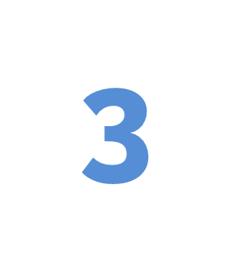

MANAGEMENT
DESIGN
MANAGE
Define project goals
Identify stakeholders
Outline value proposition
Specify functional requirements
Design presentation theme
Create Gantt timeline
Develop risk assessment table
Assign team roles and tasks
Setup GitHub repository and policy
DEVELOP
COMMUNICATE
Literature review
Data preparation & analysis
Zero-shot evaluation
Fine-tuning with PEFT
Model performance & comparison
Document on GitHub
Prepare CP1 slides
Prepare CP2 slides
Prepare CP3 slides
Prepare final slides and report
Conduct meetings with LINKS
Notes:
Before going deep into the model, I also want to show how we managed the project, because this course is not only about building a system, but also about how we organize the work.
We structured everything into four blocks:
1 ,DESIGN
First, we had a design phase.
So this phase was about thinking before building.
2 , MANAGE
This helped us avoid chaos later.
3 ,DEVELOP
After that, we moved into the actual development.
So this phase is where the main technical work happened.
4 ,COMMUNICATE
And the last part is communication.
This ensured that the project was not only done, but also well documented and clearly communicated.

Slide 10
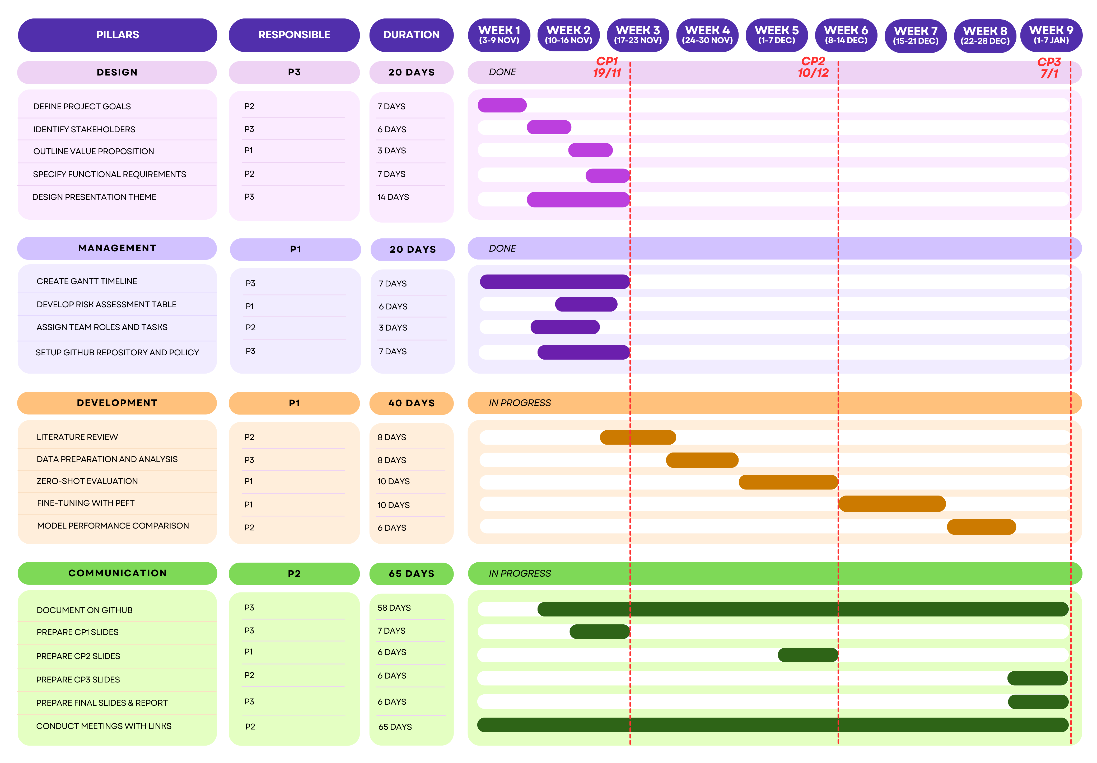
GANTT
TIMELINE
Notes:
Our project followed a clear four-phase timeline that helped us stay organized from start to finish.
First, the Design phase:
We defined our stakeholders, clarified the value proposition, gathered the functional requirements, and aligned on the overall presentation and system theme.
Then, the Management phase:
We created the task plan, analyzed risks, and assigned roles so everyone knew exactly what they were responsible for.
Next was Development:
This covered the technical work — data exploration, running zero-shot evaluations, and fine-tuning the model using PEFT to improve performance.
And finally, Communication:
We prepared all the CP slides, kept documentation updated, held meetings with the LINKS team, and delivered the final report.
Altogether, these four phases gave us a solid structure and made the project flow smoothly from idea to execution.

Slide 11

FUNCTIONAL REQUIREMENTS
1
Multimodal data acquisition and alignment
2
Reliable multimodal alignment between audio and transcription
3
Generation of emotion predictions in a standardized format
4
Reporting, explainability, and clinical integration
Notes:
On this slide, we outline the key functional requirements of our system.
First, we need multimodal data acquisition and alignment. This means collecting audio together with its corresponding text, and ensuring that both modalities are synchronized properly.
Second, the system must provide reliable alignment between the speech signal and its transcription. This is essential because emotional cues appear in both what is said and how it is said.
Third, our model has to generate emotion predictions in a standardized and analyzable format. This allows researchers, clinicians, or downstream applications to easily use and interpret the output.
Finally, we focus on reporting, explainability, and clinical integration. The system should not only make predictions, but also provide insights that are transparent and useful in real-world healthcare or research environments.

Slide 12
FUNCTIONAL DIAGRAM
PATIENTS
SPEECH AUDIO
EMOTION
CLASSIFICATION
THERAPISTS / PSYCHOLOGISTS
AUDIO ENCODER
MULTIMODAL
LARGE
LANGUAGE
MODEL
(Audio +Text)
TEXT PROMPT
TOKENIZER
RESEARCHERS
Notes:
This slide shows the high-level workflow of our system / basically how everything connects from input to output.
We start with two types of input: speech audio and text prompts.
The audio is first processed by an audio encoder, while the text goes directly into the pipeline.
Both streams are then combined inside a multimodal LLM, which fuses the information and understands the emotional context.
From that fusion, the model produces an emotion prediction / things like happy, sad, angry, or neutral.
And finally, these predictions can be used by therapists, patients, and researchers to support better emotional assessment and insights.

Slide 13

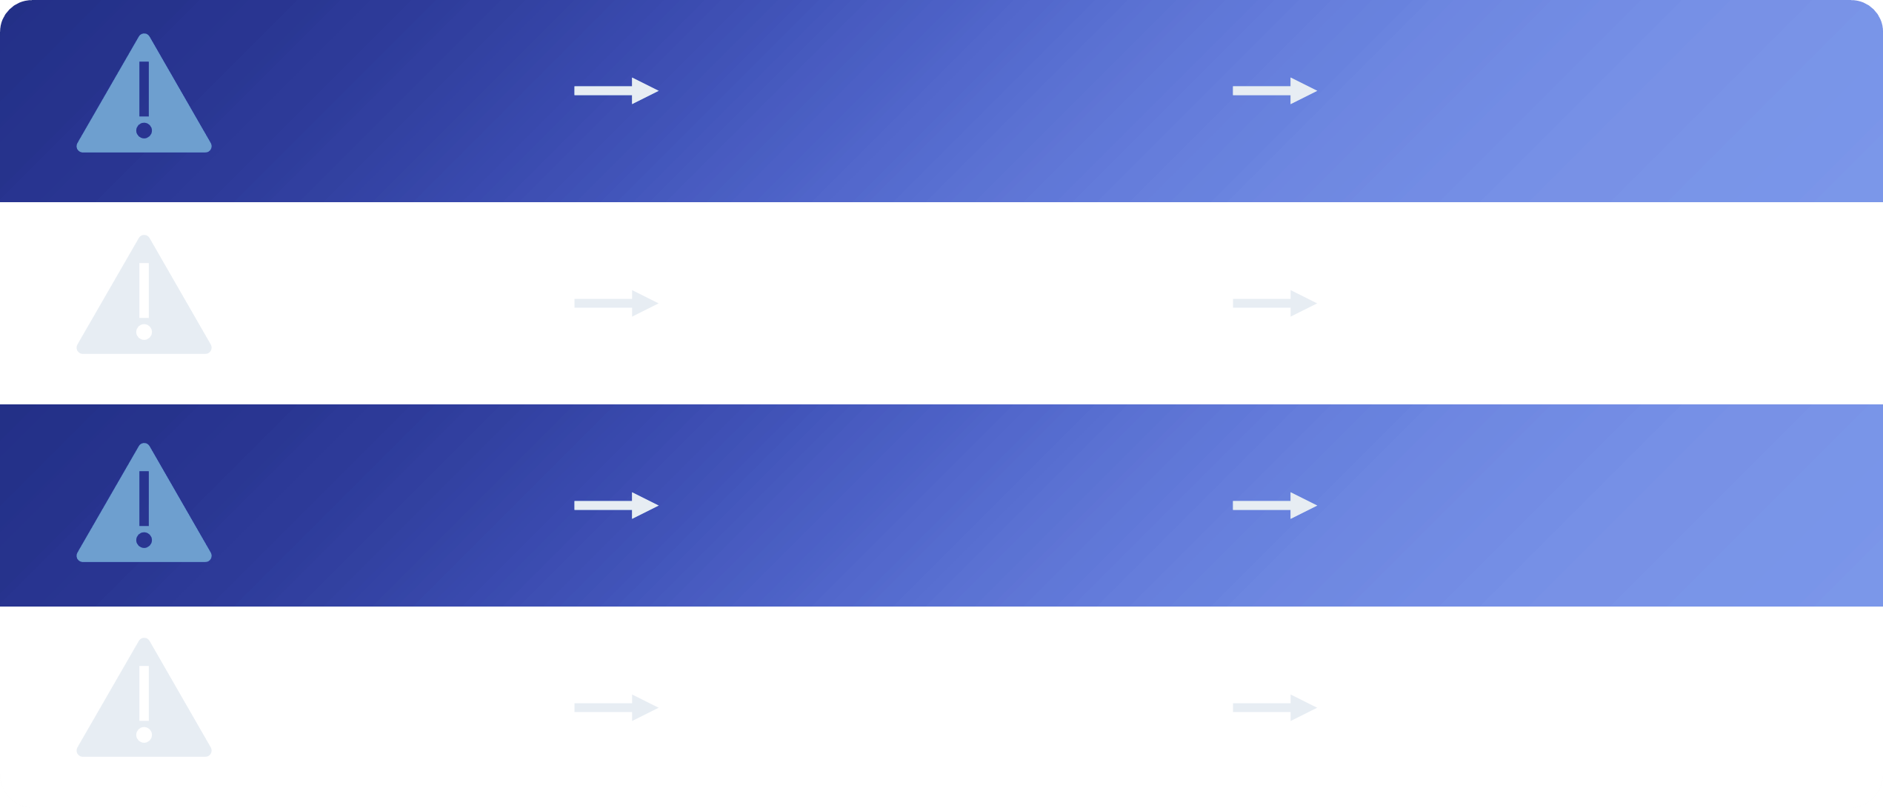
DESIGN RISK ANALYSIS
DATA QUALITY & BIAS
UNFAIR PREDICTIONS
REDUCE MODEL RELIABILITY
MULTIMODAL FUSION FAILURE
AUDIO & TEXT MISMATCH
WRONG CLASSIFICATION
OVERFITTING IN PEFT
FINE-TUNING
ADAPT TO TRAINING DATASET
POOR GENERALIZATION
PRIVACY & ETHIC
USAGE OF SENSITIVE DATA
LOSS OF TRUST & LEGAL ISSUES
Notes:
The first risk is data quality and bias. If the dataset contains noise, imbalance, or demographic bias, the model can produce unfair or inaccurate predictions. This directly reduces the system’s reliability in real-world settings.
The second risk is multimodal fusion failure. Because we combine audio and text, any misalignment or mismatch between the two modalities can lead to incorrect emotion classification.
The third risk concerns overfitting during PEFT fine-tuning. If the model adapts too strongly to the training dataset, it will not generalize well to new speakers or new emotional contexts.
And finally, we have privacy and ethical risks. Emotion data is extremely sensitive. Using it without proper consent, or handling it poorly, can lead to loss of user trust and potential legal issues. So responsible data management is crucial throughout the project

Slide 14
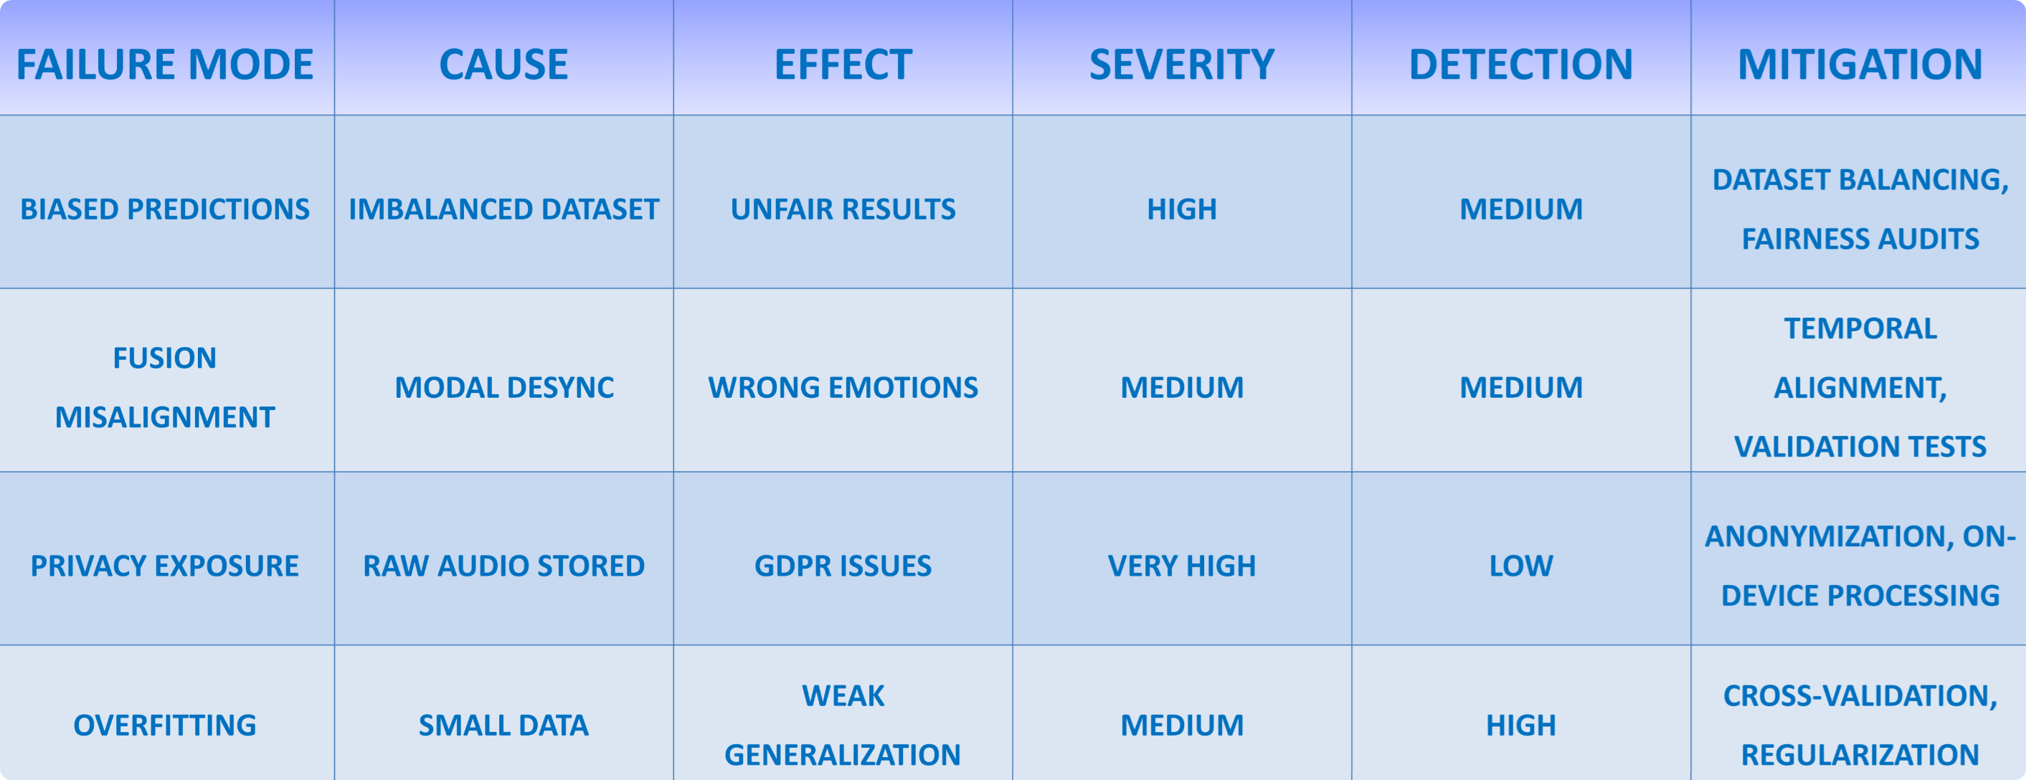
DESIGN FAILURE MODE AND EFFECTS ANALYSIS (DFMEA)
Notes:
Here we present our DFMEA — the Design Failure Mode and Effects Analysis — which helps us systematically understand potential failures in the system, their causes, their impact, and how we can mitigate them.
The first failure mode is biased predictions, typically caused by an imbalanced dataset. This leads to unfair or inaccurate results, so the severity is high. Detection is marked as medium, meaning the issue is not immediately obvious but can be identified through fairness tests. To mitigate this, we apply dataset balancing and fairness audits.
The second failure mode is fusion misalignment, where audio and text modalities fall out of sync. This results in wrong emotion predictions. Its severity is medium, and detection is also medium — it requires alignment checks but can be caught during validation. Mitigation involves improving temporal alignment and running targeted validation tests.
The third failure mode is privacy exposure, for example if raw audio is stored without protection. This can cause serious GDPR and ethical problems, so the severity is very high. Detection is low, which means these issues are difficult to identify before they cause harm. To address this, we use anonymization techniques and prefer on-device or privacy-preserving processing.
The final failure mode is overfitting, often caused by limited training data during PEFT fine-tuning. This weakens generalization to new speakers or emotions. Severity is medium, but detection is high — because performance drops clearly on validation sets. We mitigate this through cross-validation and regularization.
Before moving on, it’s important to note that Detection here refers to how easily a failure can be identified before it impacts the user: high detection means it’s easy to catch, medium requires effort to find, and low means the issue is hard to detect and therefore more risky.
Overall, this DFMEA allows us to proactively identify risks and design a more robust, fair, and trustworthy multimodal emotion recognition system.

Slide 15
THANK YOU!

